Slide 1



GACHON UNIV. AI
<PRESENTATION>
2P INSERT COIN
DTMC
DISCRETE-TIME MARKOV CHAIN
PRESS TO START
Probability & Statics Group 8

Slide 2





DTMC IS....
01. WHAT IS DTMC
02. PSEUDO CODE
INDEX
03. GAME TUTORIAL
04. GAME START!

Slide 3






WHAT IS DTMC
01
WHAT IS DTMC?
WHAT IS DTMC (DISCRETE TIME MARKOV CHAIN)?
HI! TODAY WE'RE GOING TO EXPLAIN DTMC IN A VERY SIMPLE WAY.

Slide 4












PROPERTIES
DISCRETE TIME
MARKOV CHAIN
TRANSITION
DISCRETE TIME IS
A MARKOV CHAIN IS
IN DTMC, WE USE
THE DIVISION OF TIME
THE PROCESS OF
PROBABILITIES TO MOVE
INTO RIGID UNITS.
MOVING FROM ONE STATE
FROM ONE STATE
TO THE NEXT
TO ANOTHER

Slide 5




EXAMPLE
MARKOV
>
LET ME BRIEFLY EXPLAIN DTMC!
SLEEP -> SLEEP
- PROBABILITY OF WAKING UP AND GOING BACK TO SLEEP: 20%.
Z Z Z
SLEEP -> RUN
- WHEN SLEEPING, CHANCE OF GOING FOR A RUN: 60%
SLEEP -> EAT ICECREAM
- PROBABILITY OF WAKING UP AND EATING ICE CREAM: 20%

Slide 6



PSEUDO CODE
02
PSEUDO CODE
WHAT ALGORITHM DOES DTMC WORK WITH?

Slide 7
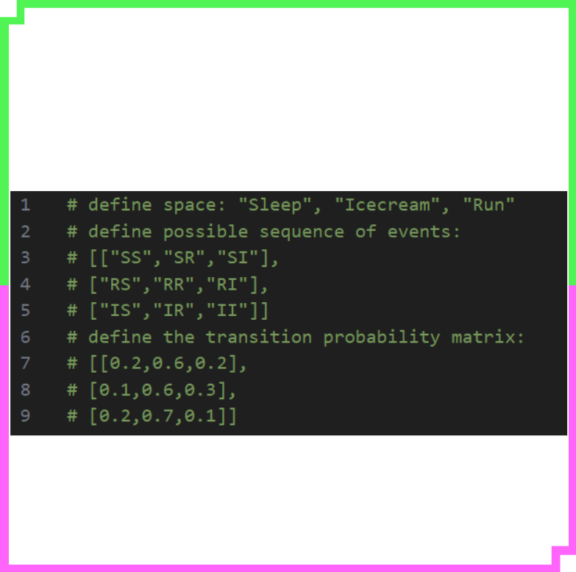

PSEUDO CODE
>
ASSUMPTIONS
SLEEP
ICECREAM
RUN

Slide 8




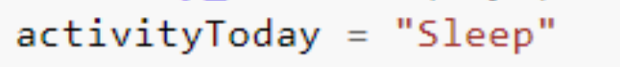








< MAIN FUNCTION >
PSEUDO CODE
20%
20%
60%
SLEEP
ICECREAM
RUN
ACTIVITY_FORECAST

Slide 9



GAME TUTORIAL
03
GAME TUTORIAL
LET'S TAKE A LOOK AT A GAME TO SEE IF YOU UNDERSTAND DTMC!

Slide 10




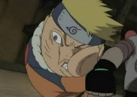





< 마법의 소라고동 >
GAME TUTORIAL
USING DTMC TO MATCH CHARACTERS
NORUTO
MIKE MOUSE
ANIME": TRUE, "MALE": TRUE, "POWERS": TRUE, "STUDENT": TRUE, "ANIMAL": FALSE
ANIME": FALSE, "MALE": TRUE, "POWERS": FALSE, "STUDENT": FALSE, "ANIMAL": TRUE
SALES MOON
DAUGHTOR GOKU
ANIME": TRUE, "FEMALE": TRUE, "POWERS": TRUE, "STUDENT": TRUE, "ANIMAL": FALSE,
ANIME": TRUE, "MALE": TRUE, "POWERS": TRUE, "STUDENT": FALSE, "ANIMAL": FALSE

Slide 11





GAME START !
04
GAME START !
LET'S ANALYZE HOW DTMC WORKS BY WATCHING A REAL GAME!

Slide 12

< SIMULATION >
GAME START!
SPONGEBOB MOVES FORWARD UNTIL HE REACHES THE CONCH!

Slide 13

< SIMULATION >
GAME START!
WHEN YOU TOUCH THE CONCH, SPONGEBOB WILL ASK YOU A QUESTION!

Slide 14
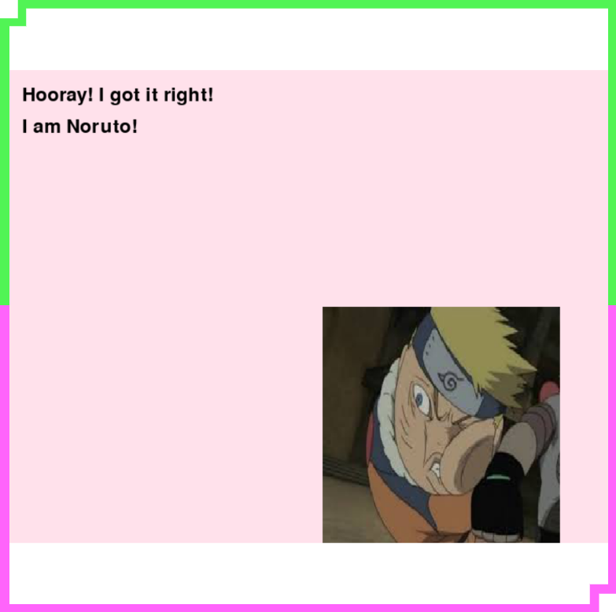
< SIMULATION >
GAME START!
YOU'LL GET THE CORRECT ANSWER BASED ON THE PROBABILITY OF THE CHARACTER YOU'RE LOOKING FOR HAVING THE TRAIT!

Slide 15
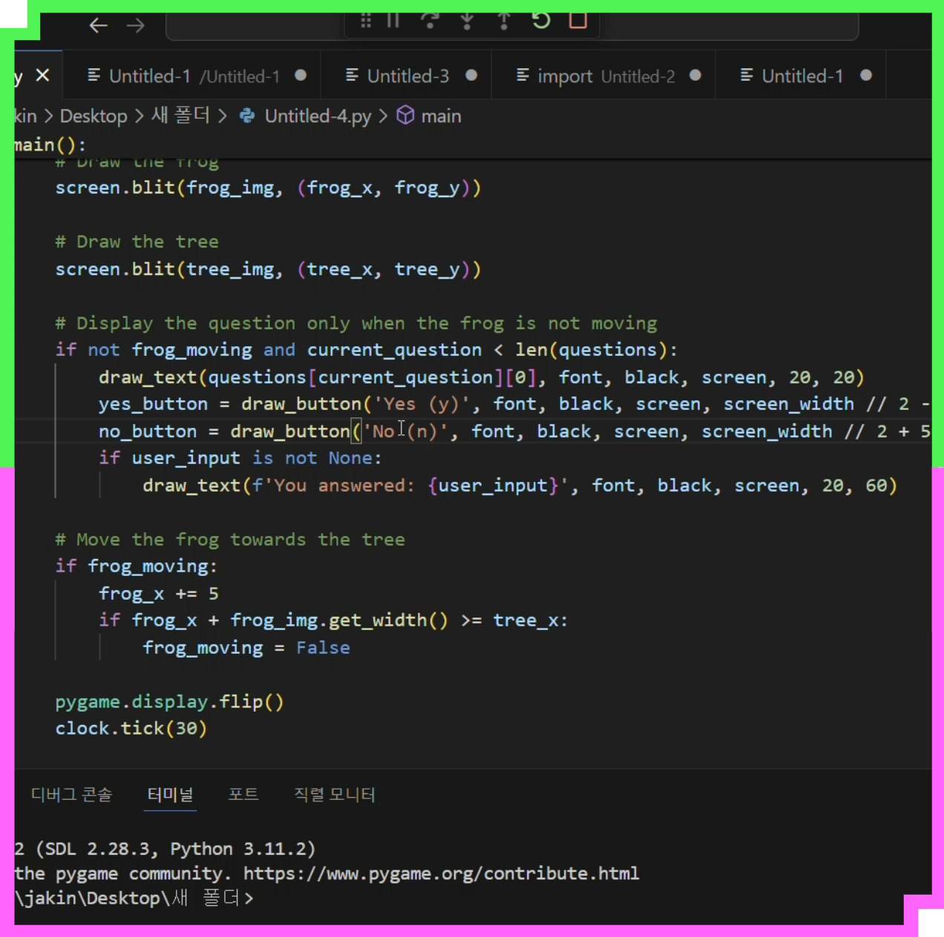
GAME START !
PLAY
VIDEO

Slide 16
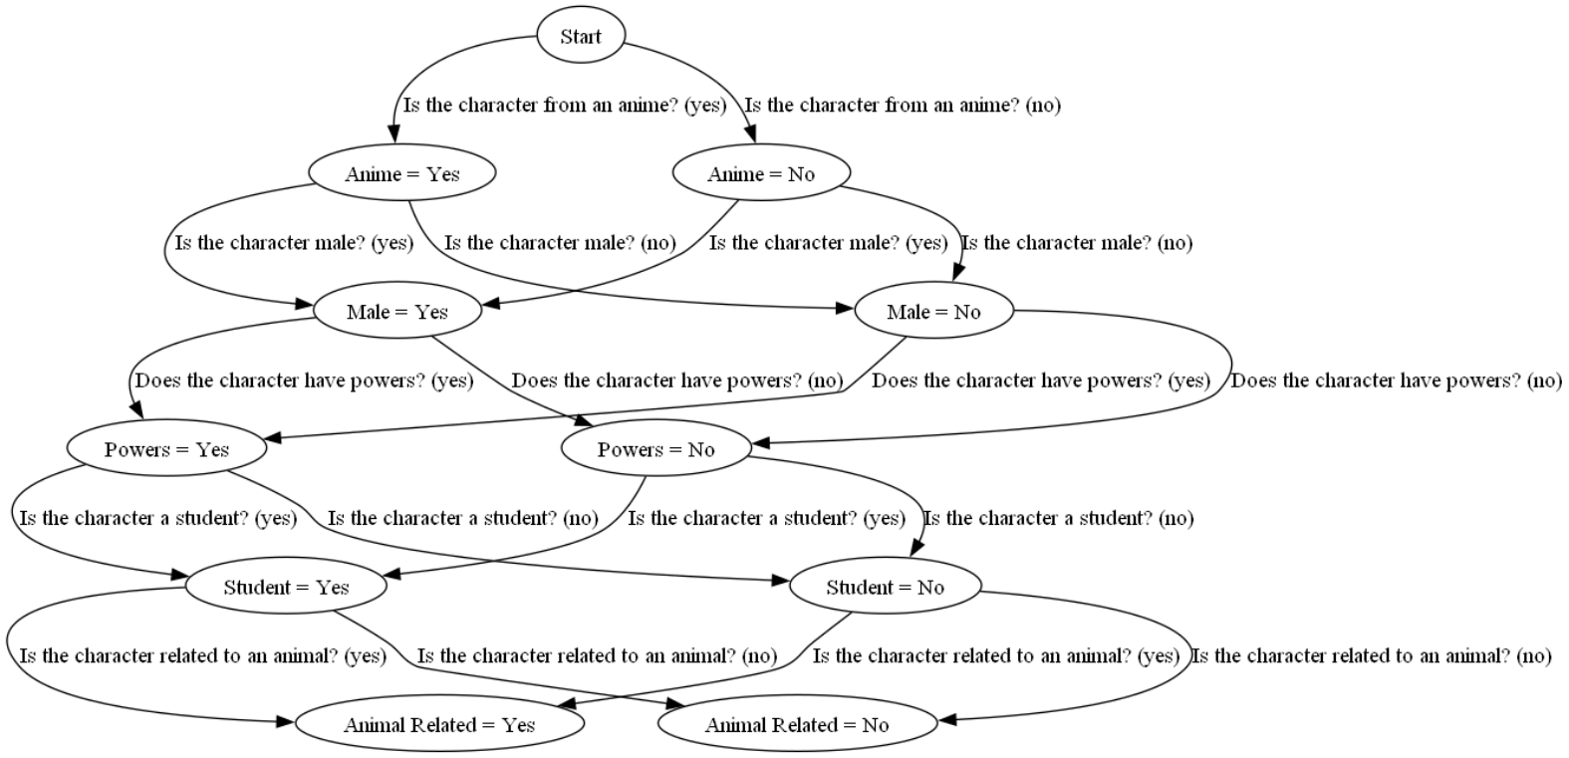
GAME EXPLANATION

Slide 17
DTMC
<PRESENTATION>
2P INSERT COIN
THANK YOU
PRESS TO START
Probability & Statics Group 8

